Slide 1

Toilets In Australia
By G7: Ethan Ericson, Jaxon Ham, Andrew Mendez, Medhansh Sankaran, Ethan Styles
Notes:
Ericson

Slide 2
Our Role in Public Health
As members of the Australian Department of Health and Aged Care (DHAC), we have a responsibility to the nation to preserve and improve public health.
One of the most effective ways we can accomplish this goal is improving access to public toilets that fulfill people’s basic hygiene needs.
By looking at the location of toilets in Australia, we can identify areas where hygiene needs are less likely to be satisfied. From here, we can delve into the availability of these toilets to specific demographic groups, as well as look into how these toilets are affecting all peoples in the area.
Notes:
Ericson

Slide 3

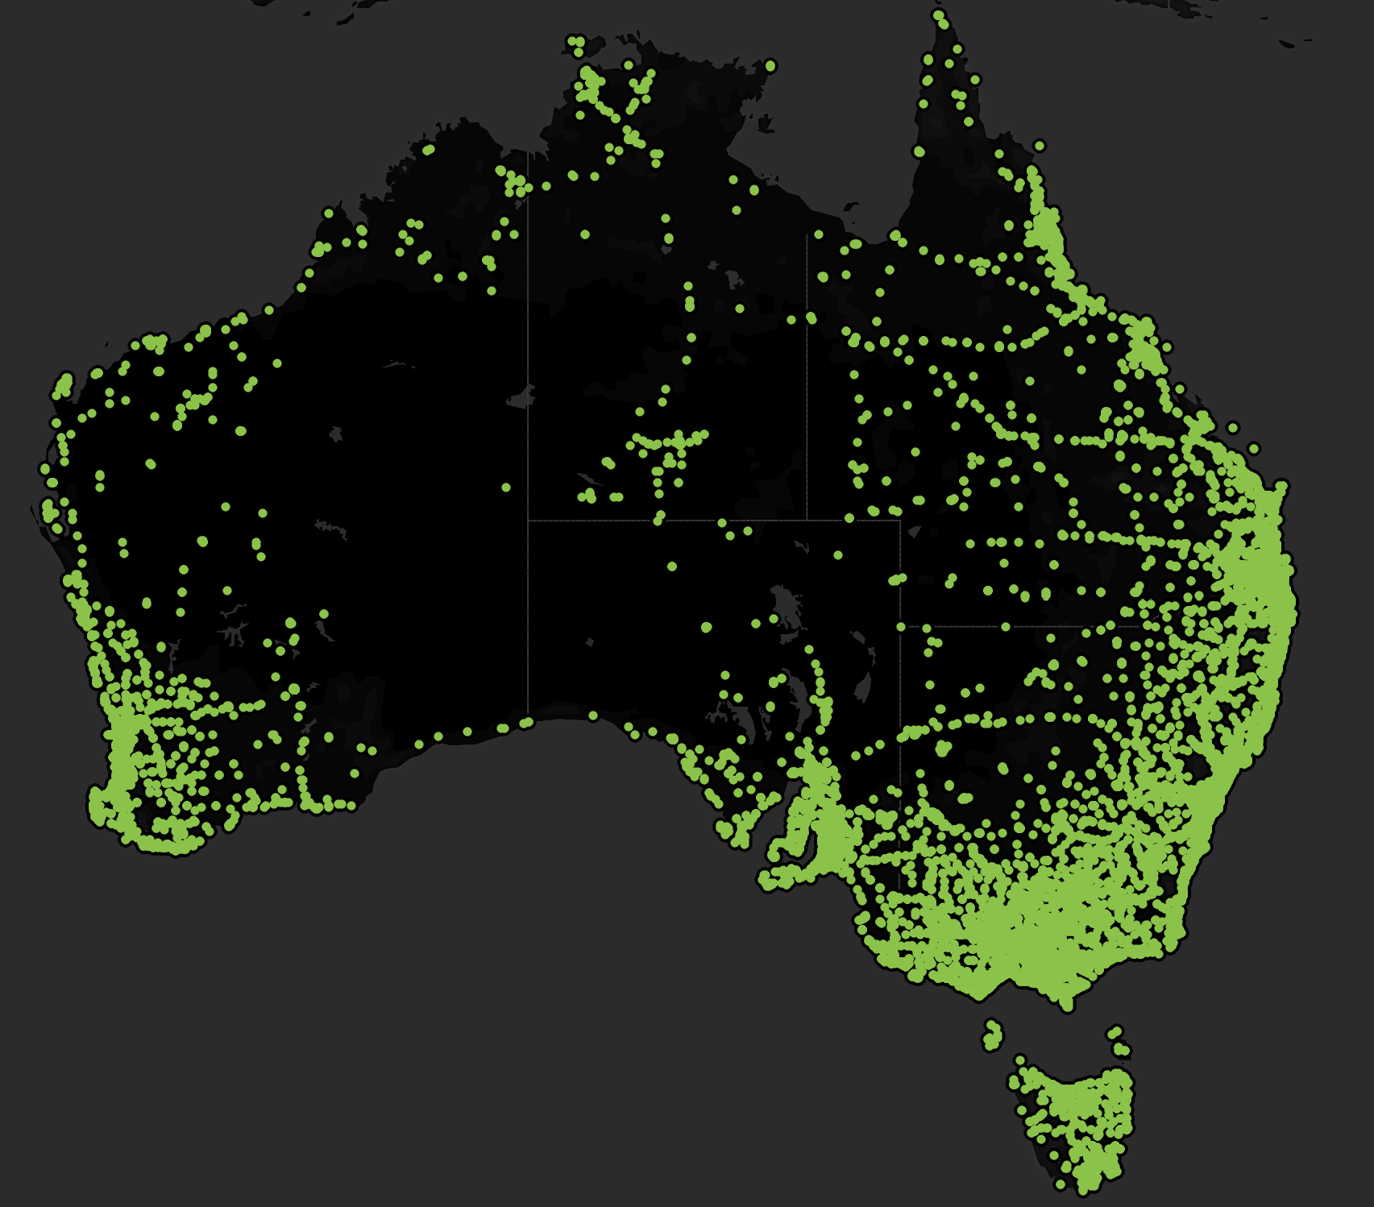
Toilet Locations
Most toilets are clustered around the coasts, where the major population centers of Australia are.
There are not a lot of toilets in the center of Australia, where the inhospitable nature of the Outback leads to low population density.
Notes:
Styles

Slide 4
Toilets and Gender
How can we provide more universal access to basic hygiene for people of varied genders?
Notes:
Styles

Slide 5
Understanding Gender
Two types
Gendered = Male & Female
Unisex
Looking into the prevalence of Unisex can reveal insights into what areas are more developed and even provide insights into local political climates
Notes:
Styles

Slide 6

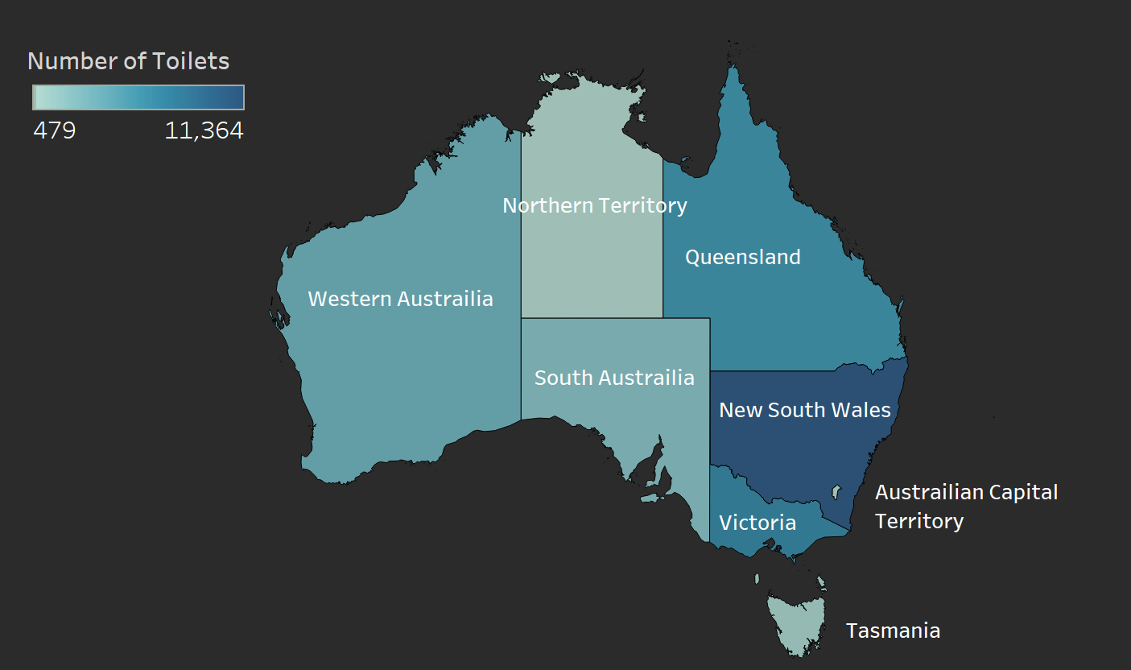
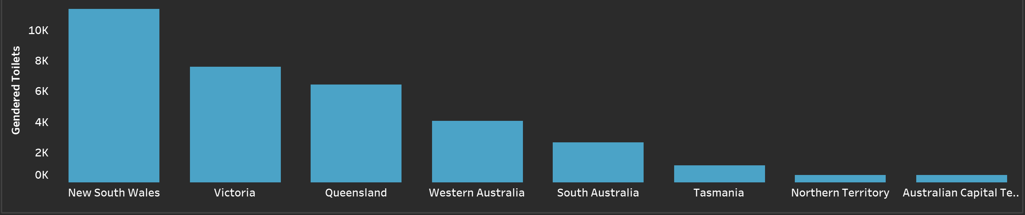
Where are Gendered Bathrooms?
Male and Female Toilets were equal throughout the country
Toilets follow same distribution as Australian population
Notes:
Styles

Slide 7
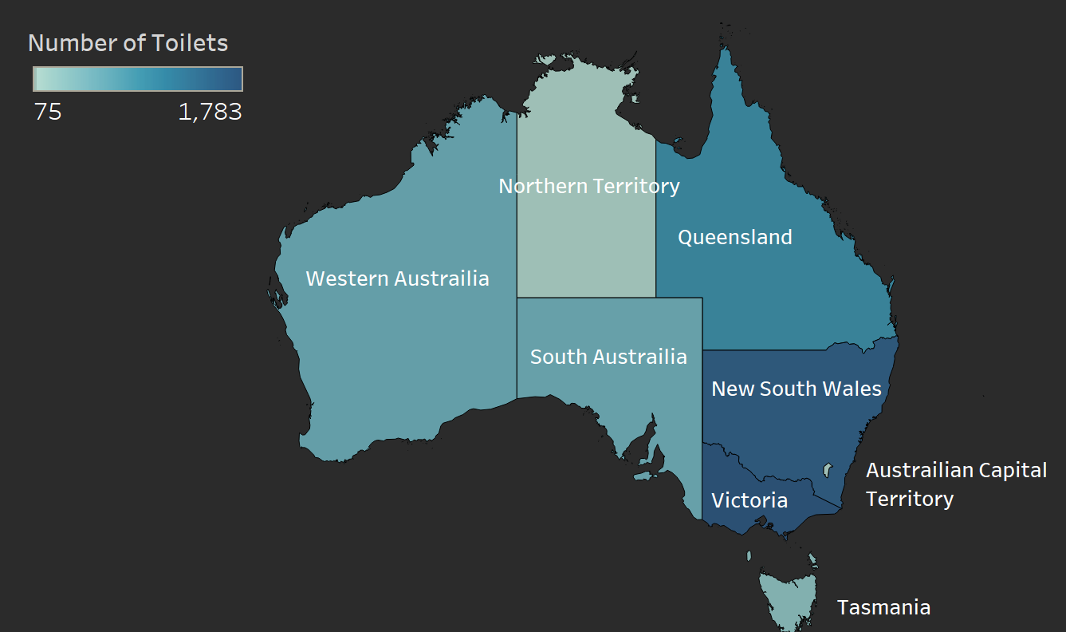
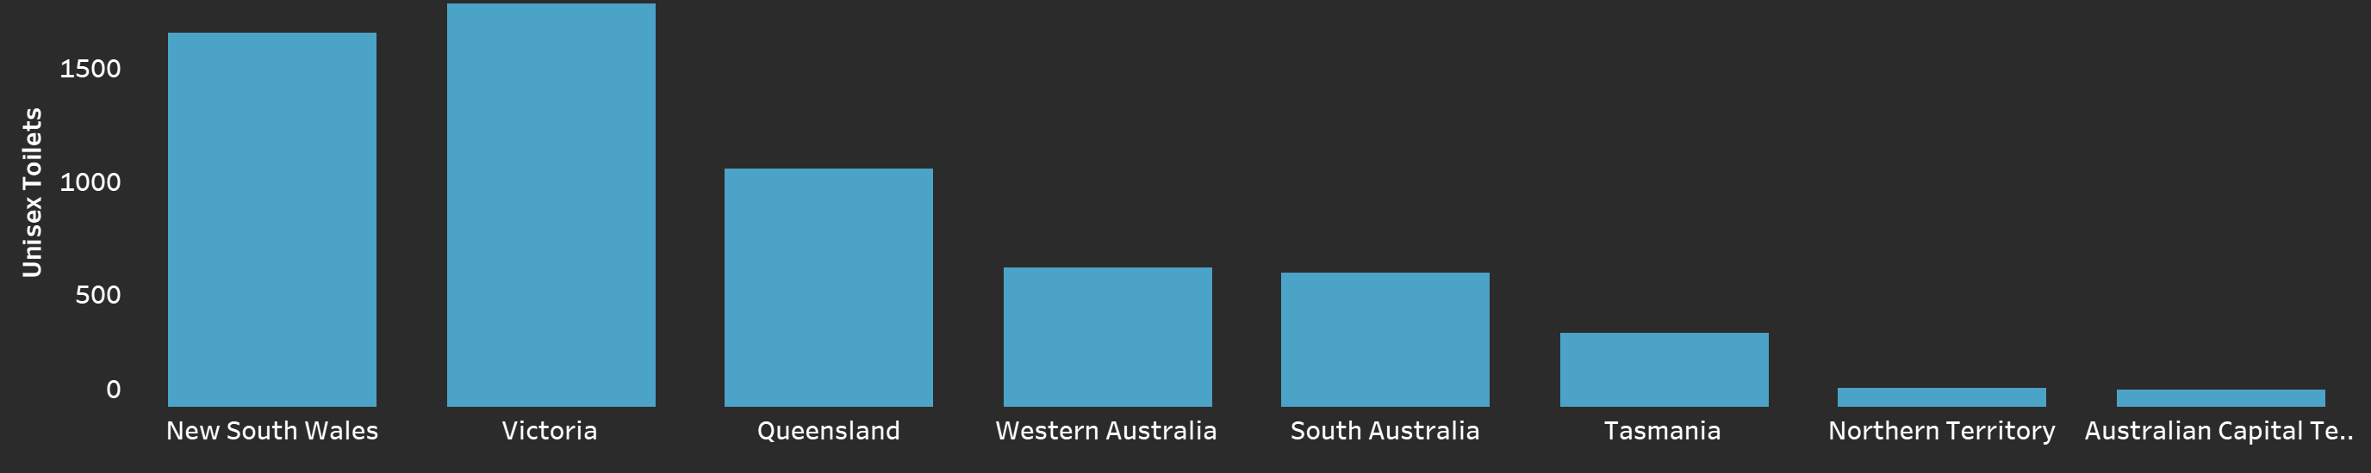
Where are Unisex Bathrooms?
Unisex bathrooms number much less than the Gendered bathrooms
Unisex bathrooms crowd in the states with cities
Possibly due to more progressive views or a need for lower operating costs
Notes:
Styles

Slide 8
Desired Action
More Unisex Toilets
Less space
Cheaper to construct and operate
Functionally Identical
Notes:
Styles

Slide 9
Toilets and Travel
How accessible are necessary hygiene facilities to travelers along our major roads?
Notes:
Ericson

Slide 10
Understanding Travel
Travelers along the major roads of our nation are an important group to look at when evaluating the availability of public toilets. This group doesn’t have access to their personal toilets while on the road, so they rely heavily on public toilets to meet their hygiene needs.
The most important aspects of a public toilet to traveler hygiene are:
Showers
Dump Points – Receptacles for emptying sewage, like from an R.V.
Notes:
Ericson (explain why for each metric)

Slide 11
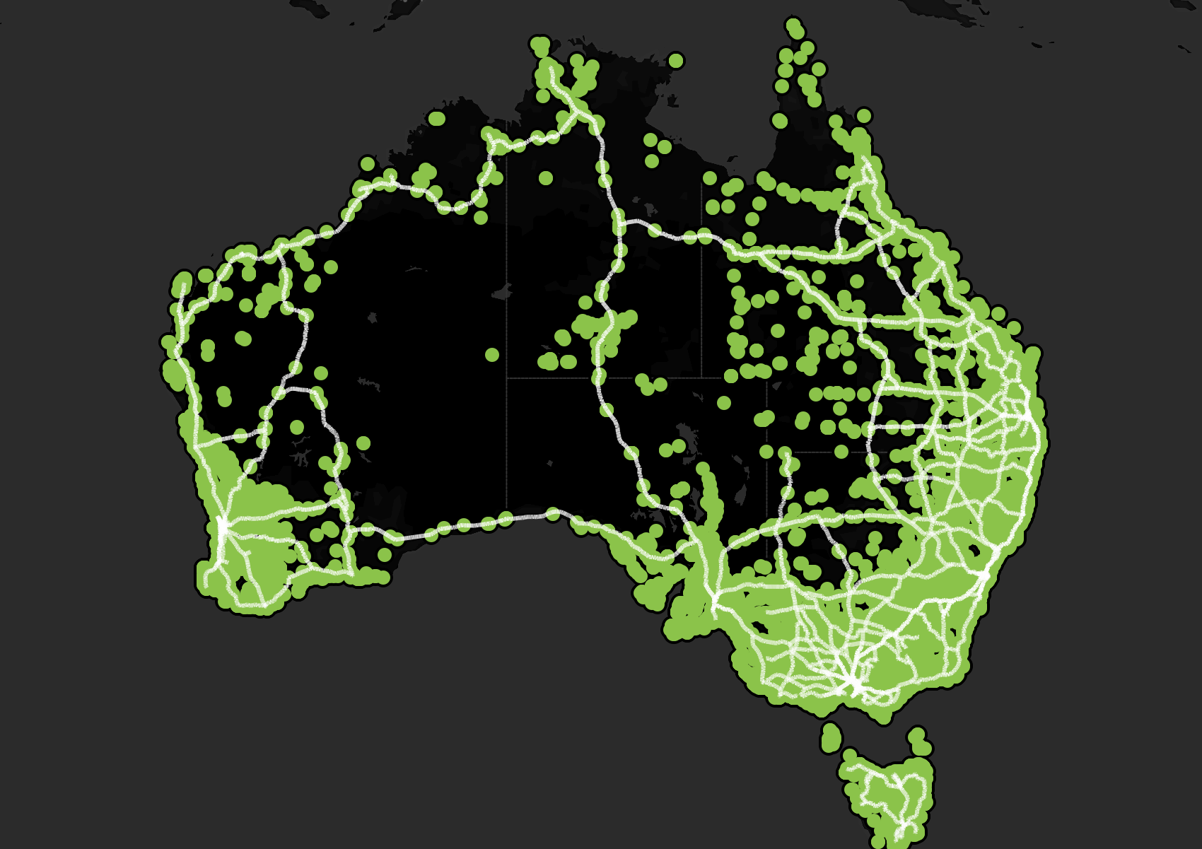
Where are the roads?
More roads in urban areas than in the Outback.
Toilets are present near all major roads but are much more common in urban areas.
Notes:
Ericson

Slide 12
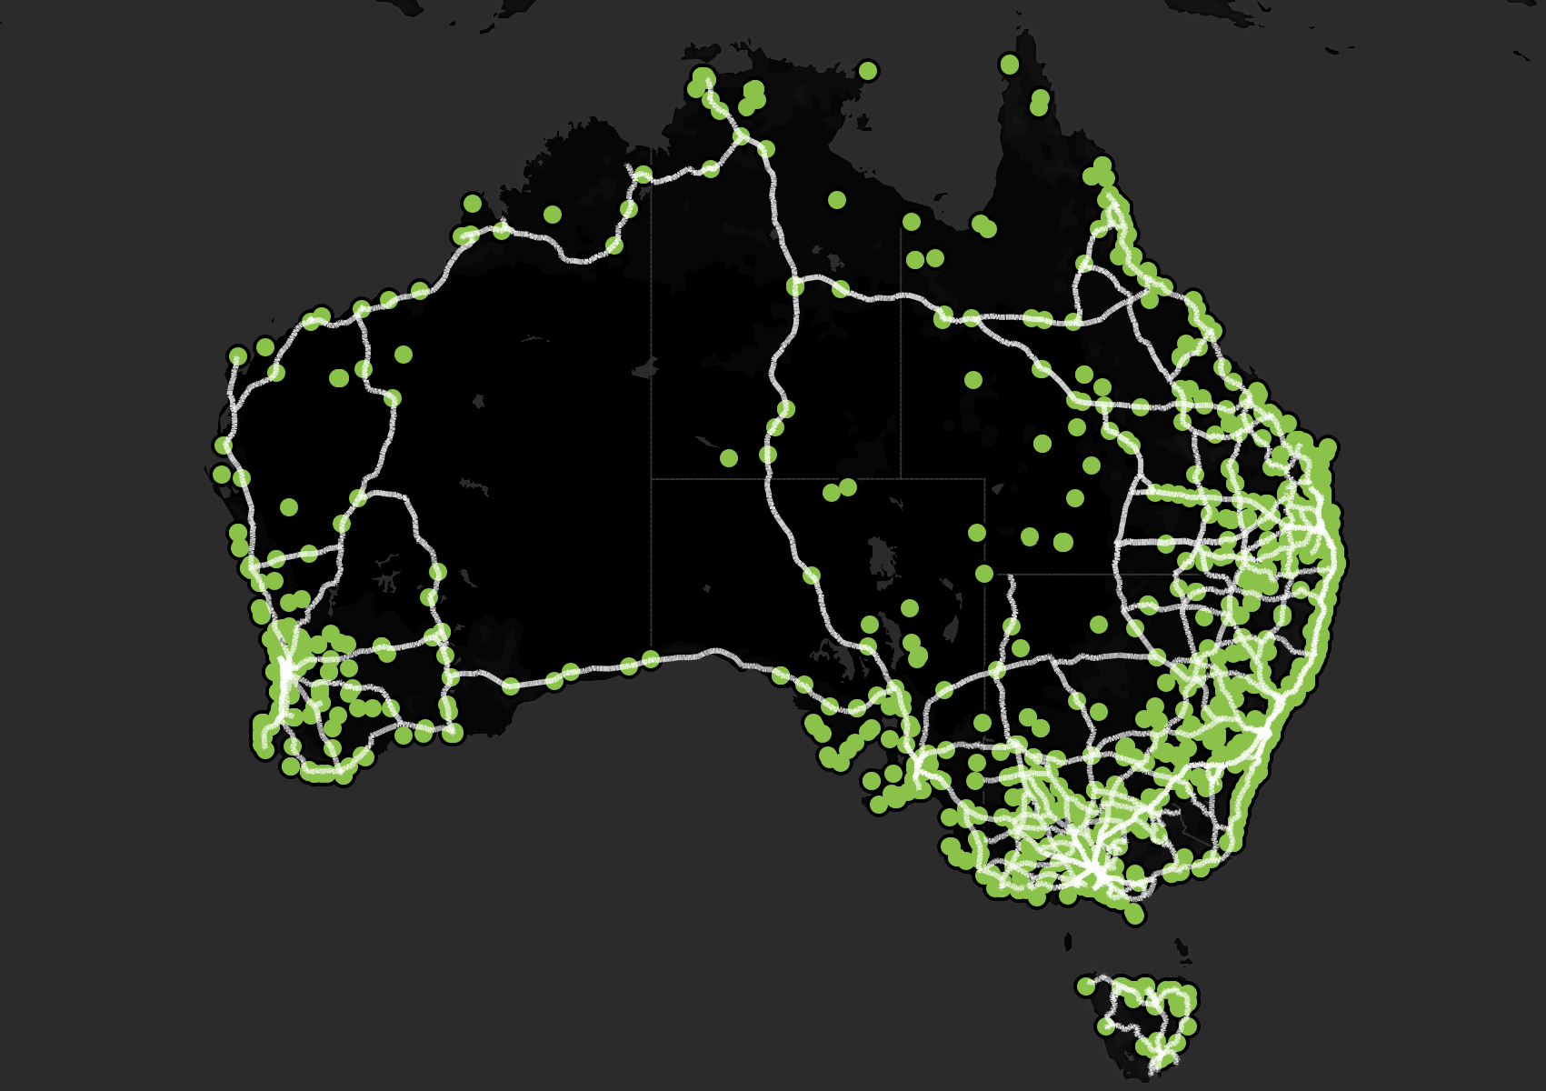
Where are the showers?
Only 7.8% of toilets have showers, and most of these toilets are along the coast.
This leaves many major roads without a toilet that contains a shower.
Notes:
Ericson

Slide 13
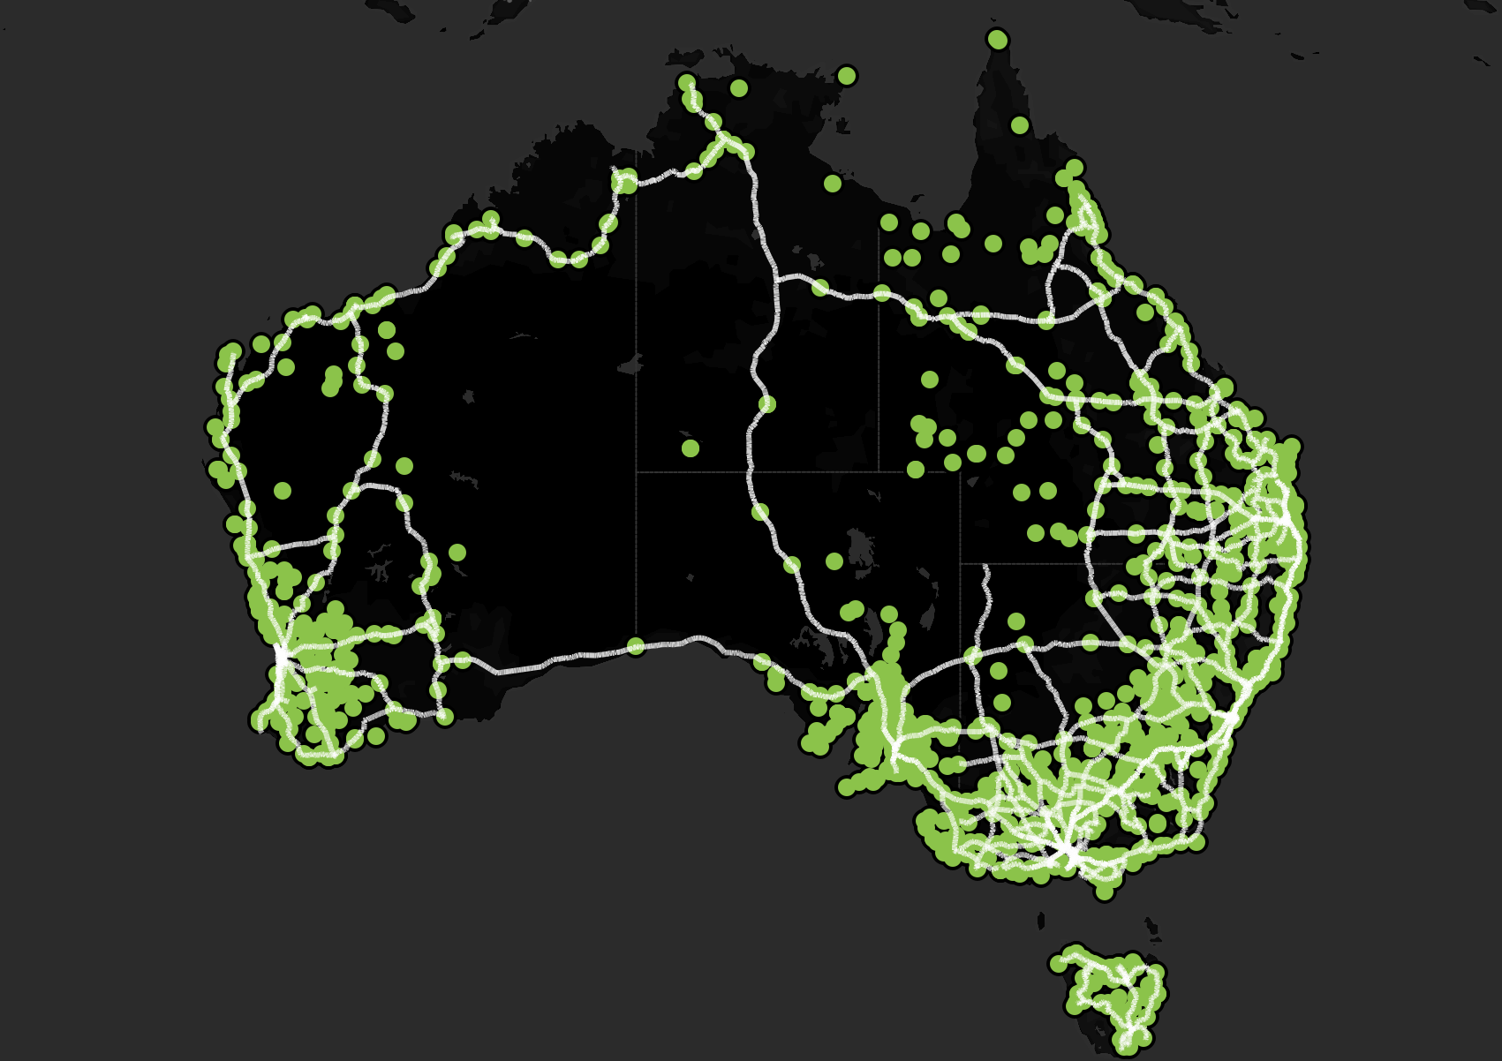
Where are the dump points?
Only 5.4% of toilets have a dump point for sewage.
As with showers, most of these toilets are along the coasts.
As a result, travelers in the Outback are more likely to experience sewage overflows since they can’t dispose of their waste frequently using a dump point.
Notes:
Ericson

Slide 14
Desired Action
To ensure that travelers have consistent access to basic hygiene, we need to increase the number of toilets near roads in the Australian Outback, and we need to add the amenities of showers and dump points to these new facilities as well as old ones in the areas.
Notes:
Ericson

Slide 15
Toilets and Accessibility
How accessible are necessary hygiene facilities to people with disabilities?
Notes:
Jaxon

Slide 16
Understanding Accessibility
Accessibility Features
Importance of Accessibility
Accessible Toilets
Accessible Parking
Adult Changing Rooms
Left-Handed Rails
Right-Handed Rails
Promotes Inclusion
Legal Compliance
Improves Usability
Public Safety
Enhanced Community Image
Encouraged Participation
Notes:
Jaxon
Promotes Inclusion: make sure people with disabilities can use facilities on there own and with dignity
Legal Compliance: sometimes certain facilities are legally required to provide accommodations (think of ADA in the US) Improves Usability: accessibility features also help old people, parents w/ strollers, and people with temp injuries
Public Safety: safety features decrease accident/injury risk for people with mobility issues
Enhance Community Image: shows that the community is engaged and supportive of entire population
Encouraged Participation: individuals with disabilities are encouraged to participate more fully in public life

Slide 17
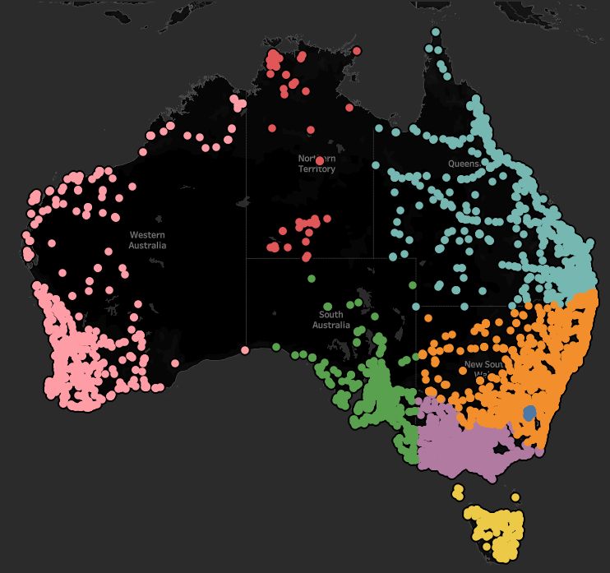
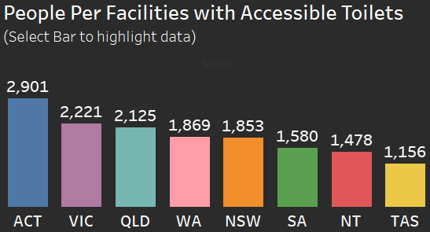
Facilities with Accessible Toilets
58 % of Facilities have Accessible Toilets
The Australian Capital Region shows the greatest need per capita
Also consider central region, where access is limited by distance
Notes:
Jaxon

Slide 18
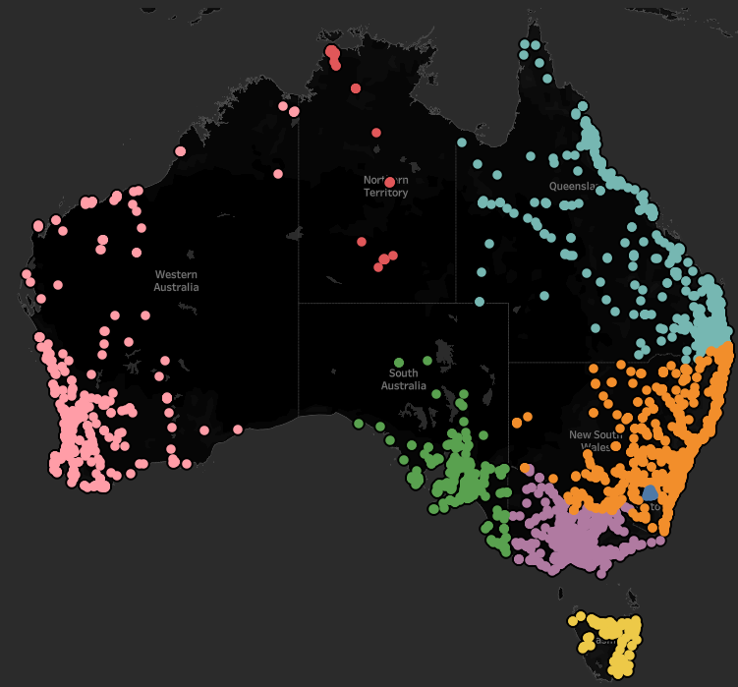
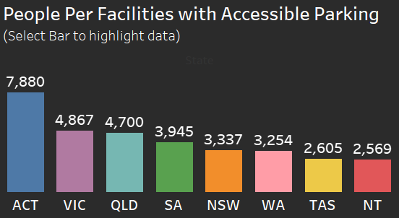
Facilities with Accessible Parking
29 % of Facilities have Accessible Parking
Only 43 % of Accessible Toilets have Accessible Parking
The Australian Capital Region shows the greatest need per capita
Notes:
Jaxon

Slide 19
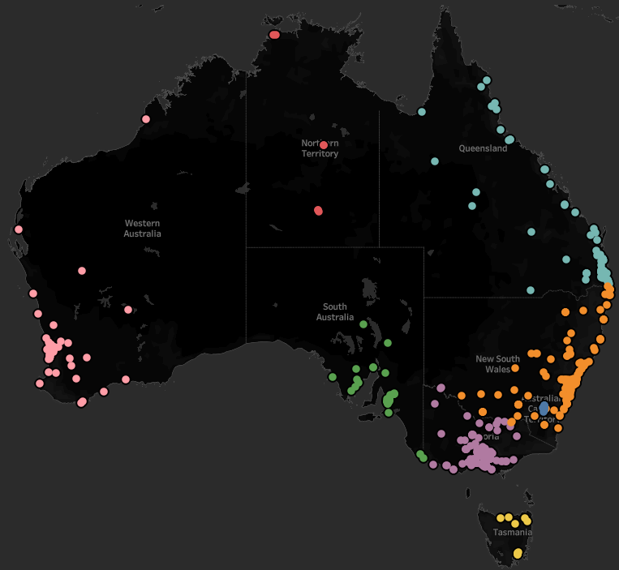
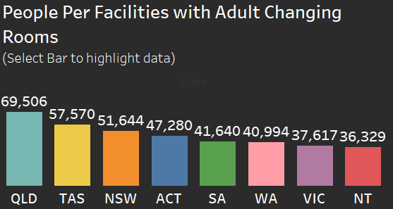
Facilities with Adult Changing Rooms (ACR)
2.4 % of Facilities have ACR
Queensland Region shows the greatest need per capita, but lacking overall
Rural citizens must travel great lengths to find one
Notes:
Jaxon

Slide 20
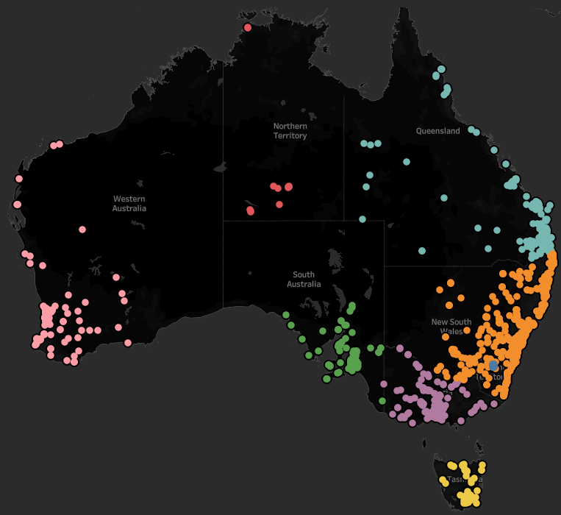
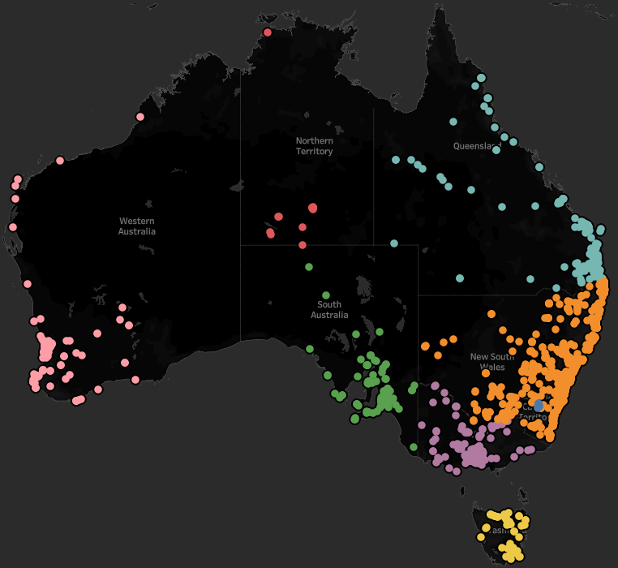
Rail Accessibility
Left-Handed
Right-Handed
7.8% of Facilities
Australian Capital Region (~36,000/1)
8.7% of Facilities
Australian Capital Region (~43,000/1)
Notes:
Jaxon

Slide 21
Desired Action
More Accessibility features are needed in two places:
Population Dense Areas: to account for high usage/preventing overconsumption
Rural Areas: promote locational access & cut down on travel time
Notes:
Jaxon

Slide 22
Toilets and Pollution
How are existing toilets impacting the environment?
Notes:
Medhansh

Slide 23
Understanding Pollution
There are three major types of pollution, all measured by emissions in kg/year.
Air
Water
Land
Keeping pollution mitigation in mind is essential to construction in any case, including toilet infrastructure.
Notes:
Medhansh

Slide 24
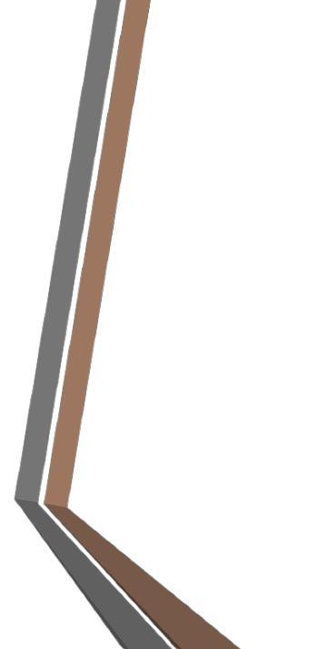
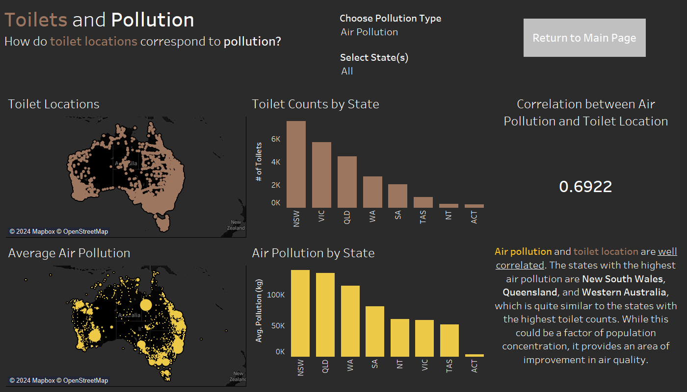
Air Pollution
Notes:
Medhansh

Slide 25
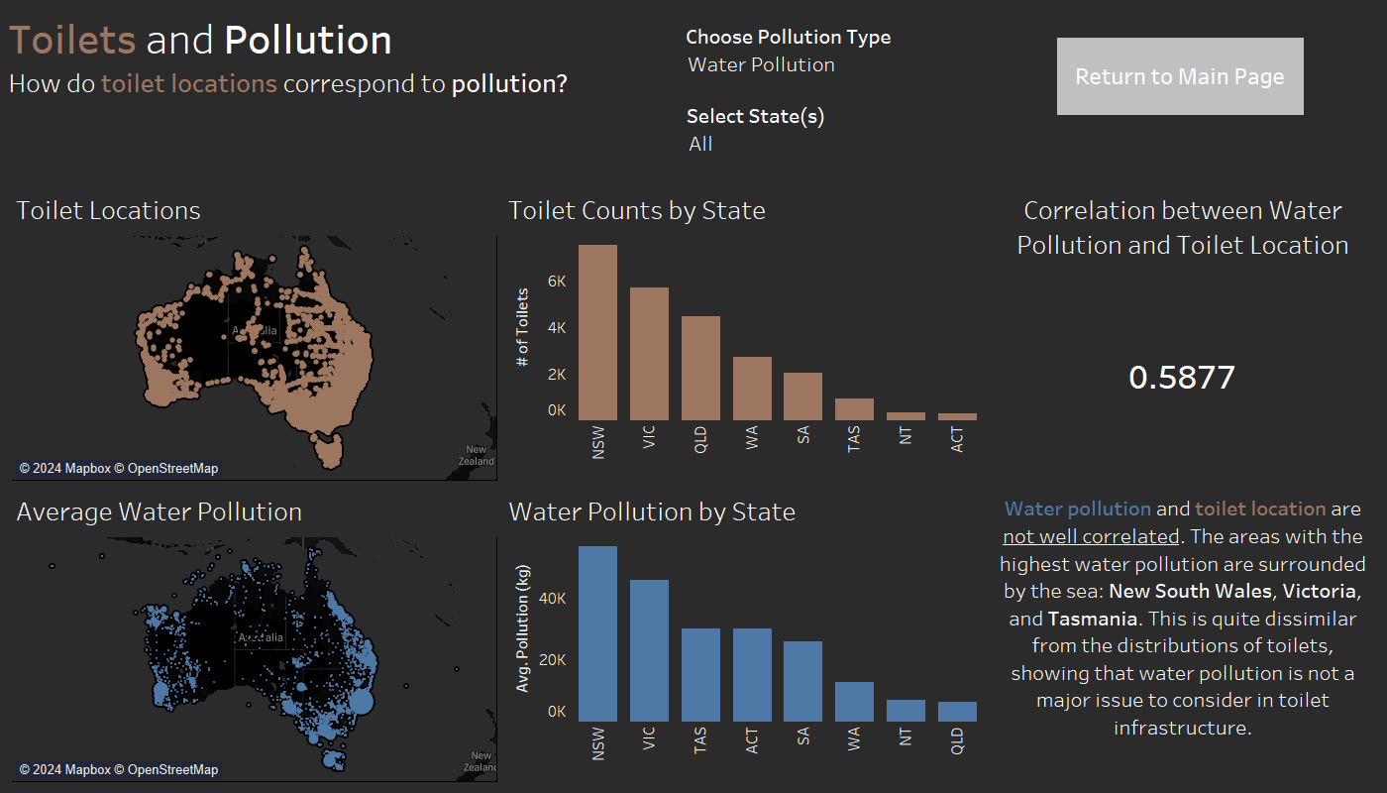
Water Pollution
Notes:
Medhansh

Slide 26
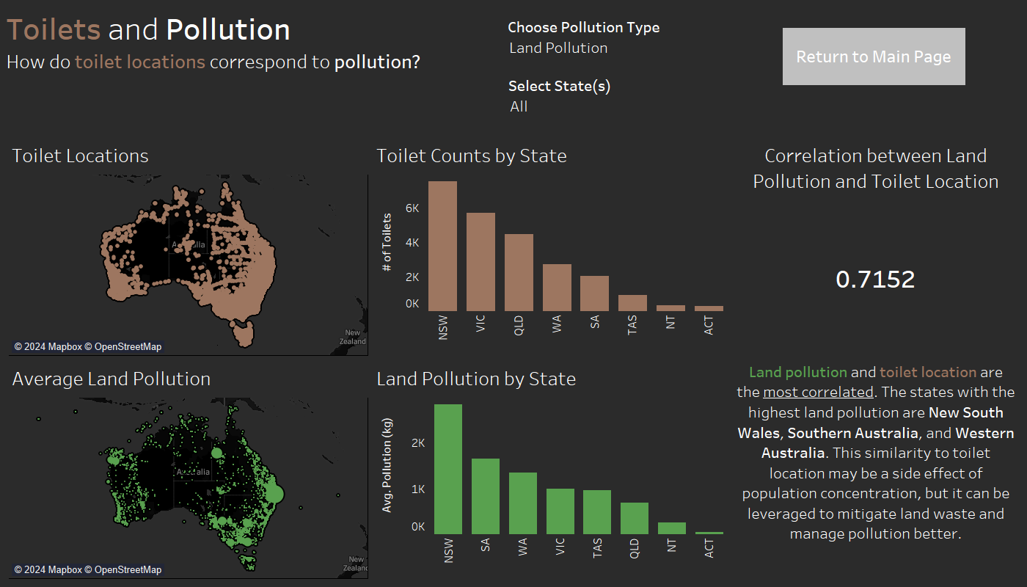
Land Pollution
Notes:
Medhansh

Slide 27
Desired Action
Water Pollution does not correlate well to toilet location and does not need to be considered further in toilet infrastructure.
Air Pollution and Land Pollution are more correlated and should be considered.
Higher quality filters for better airborne particle capture
More secure disposal measures for solid waste and seepage prevention
Notes:
Medhansh

Slide 28
Toilets and Disease
How are existing toilets impacting disease and mortality rates in nearby towns?
Notes:
Andrew

Slide 29
Understanding Disease/Mortality
To understand the relationship between toilets and disease/mortality, we looked at the following by town:
Cardiovascular (Heart) Disease
Kidney Disease
Mortality Rates
Notes:
Andrew

Slide 30
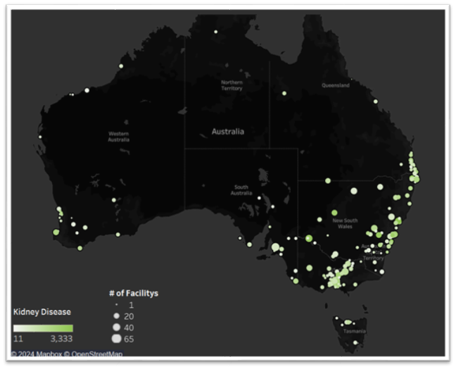
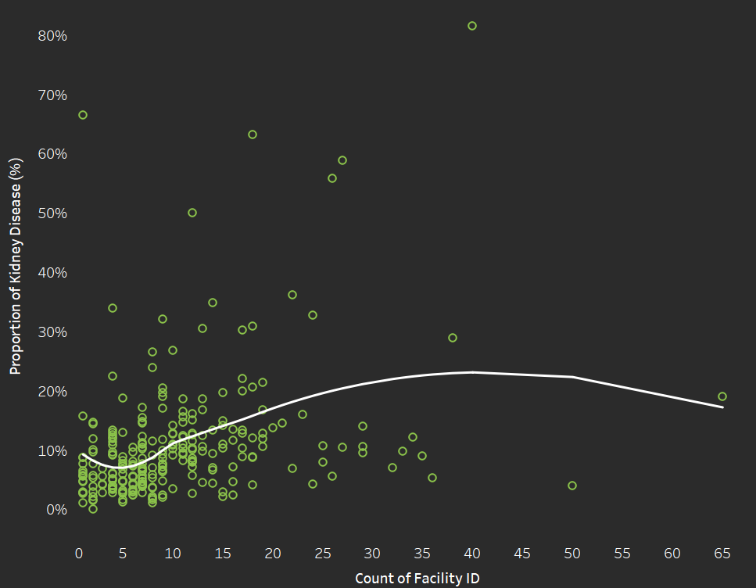
Kidney Disease
Results Summary:
Scatter Plot Analysis:
Weak or no correlation between the number of facilities and the percentage of the population affected by kidney disease.
LOESS smoothing trends were inconsistent.
Map Analysis:
Spatial distribution of public facilities showed no apparent relationship to kidney disease prevalence depending on number of facilities
Conclusion:
Both scatter plot and map analyses suggest that the number of public facilities does not significantly influence kidney disease prevalence.
Notes:
Andrew

Slide 31
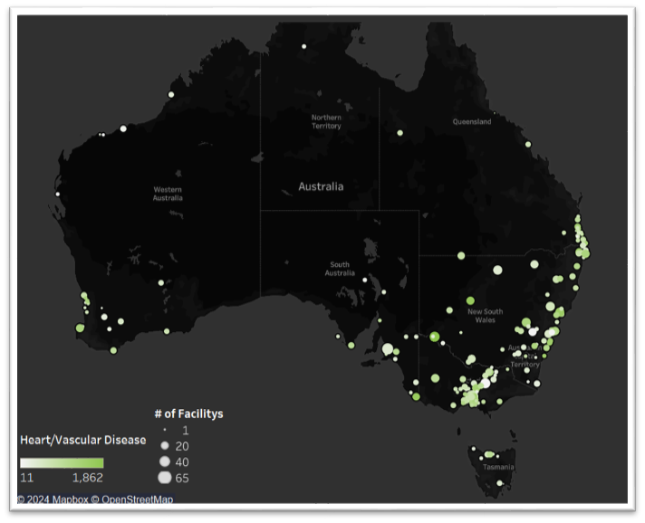
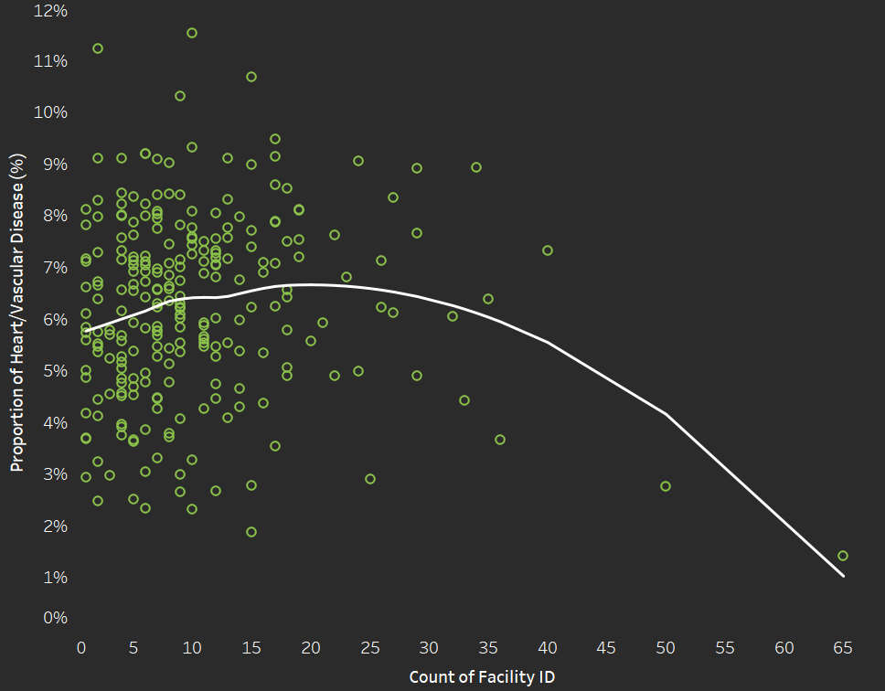
Heart/Vascular Disease
Results Summary:
Scatter Plot Analysis:
No visible correlation between the number of facilities and heart/vascular disease prevalence.
LOESS smoothing patterns were weak and inconsistent.
Map Analysis:
No geographic patterns suggesting a relationship between facility number and heart/vascular disease prevalence.
Conclusion:
Neither map nor scatter plot analyses indicate a measurable impact of facility counts on heart/vascular disease prevalence.
Notes:
Andrew

Slide 32
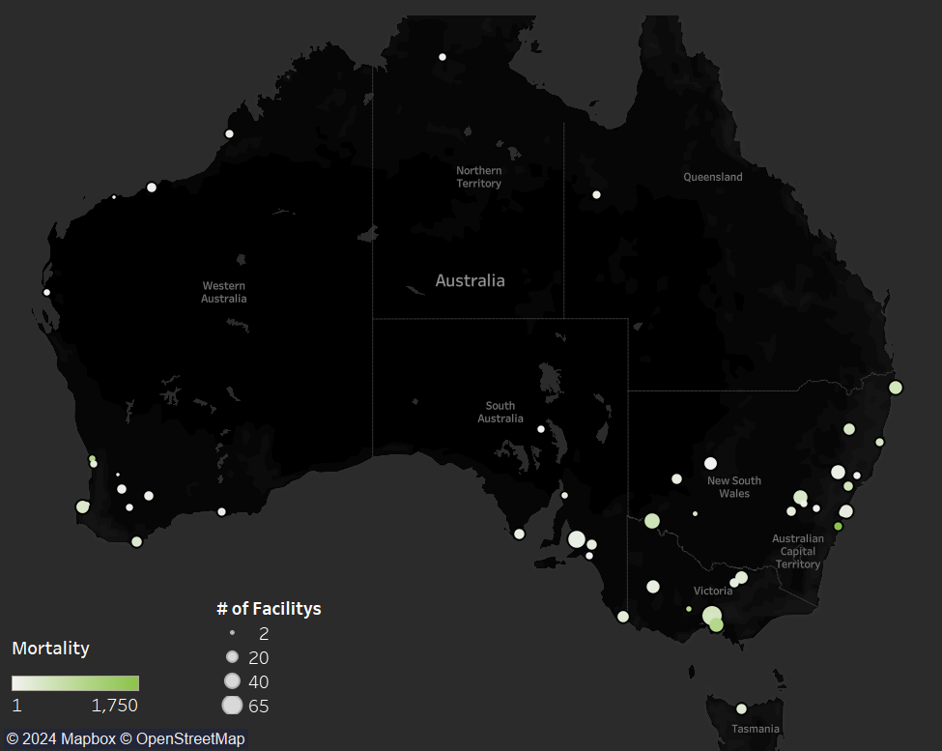
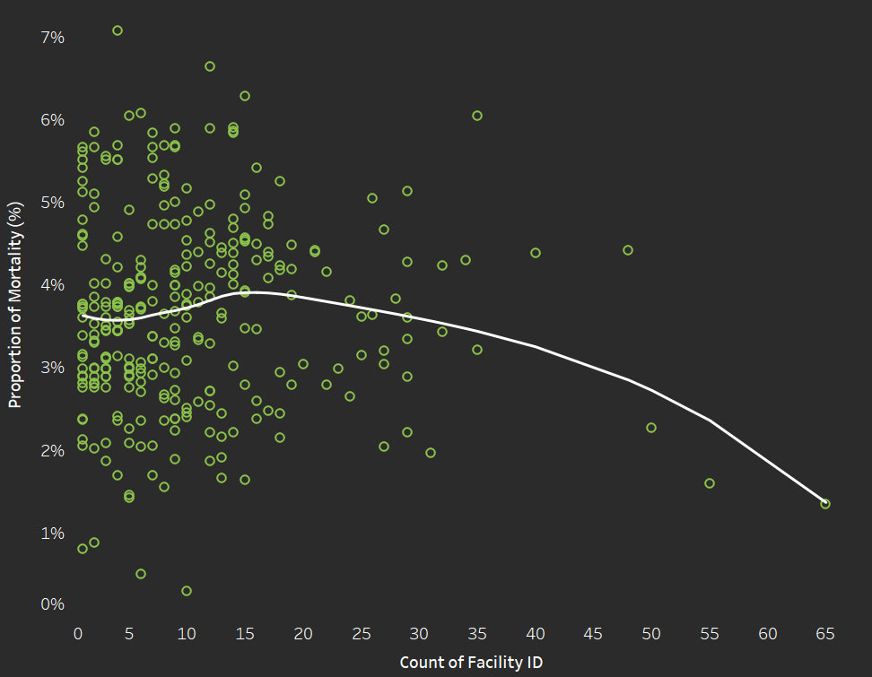
Mortality
Results Summary:
Scatter Plot Analysis:
Minimal to no correlation observed between facility counts and mortality rates.
LOESS trends offered no clear direction or pattern.
Map Analysis:
Spatial distribution of public facilities did not correlate with mortality rates by number of facilities.
Conclusion:
Both scatter plot and map analyses suggest no relationship between public facility counts and mortality rates.
Notes:
Andrew

Slide 33
Desired Action
Key Takeaways:
The analysis shows no significant correlation between public facility counts and health metrics (kidney disease, heart/vascular disease, mortality rates).
Simply increasing the number of public facilities is unlikely to directly improve health outcomes.
Next Steps:
Look into Facility Quality and Accessibility
Investigate Confounding Variables
Develop More Comprehensive Metrics
Notes:
Andrew

Slide 34
Conclusion
What is our solution to increasing the availability of necessary hygiene facilities?
Notes:
Ericson

Slide 35
Solution
How do we increase access to basic hygiene across out nation?
Using the location of toilets as an indicator of struggling areas, we can:
Create more Unisex toilets nationwide to promote gender inclusivity and reduce operating costs.
Increase the number of toilets near major roads in the Australian Outback with showers and dump points.
Increase the number of accessible toilets in the Australian Capital Region and central Australia by constructing or upgrading existing facilities.
Control the escape of air and land pollutants through the integration of high-quality particle filters and better disposal methods.
Further explore the connection between disease and toilets in our nation.
Notes:
Ericson does first part - Each person does their respective

Slide 36


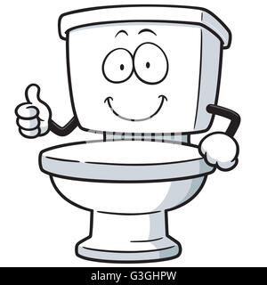

Thank You!

